Slide 1
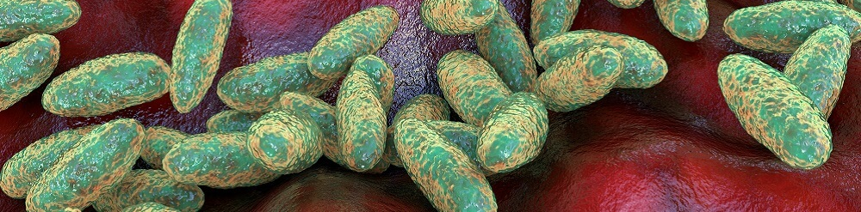
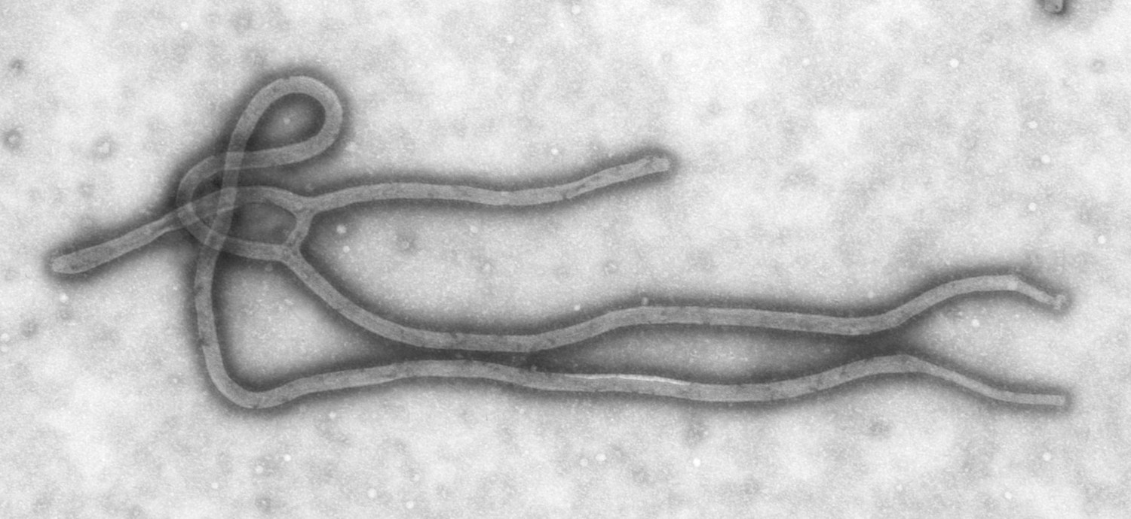
"Protein superglue to build vaccines"
Mark Howarth Lab, Dept of Pharmacology
Spin the Wheel -
find out which vaccine to build
1
Coronavirus
8
Zika
2
Influenza
9
Plague
3
Ebola
10
Disease X
4
Nipah
5
Marburg
6
Lassa
7
Poxvirus

